Slide 1
Python Implementation – kNN classiffier
Srikanth Gunturu
Guest Faculty
BITS, WILP

Slide 2
In this segment
Python Implementation – kNN classiffier
Tech stack and library introduction
kNN classifier implementation in Python
Load the data
Split the dataset
Build and fit the model
Test the model
Plot the metrics
Optimize K

Slide 3
Python Implementation – kNN classiffier
Tech stack and libraries used
Base language - Python 2.x
KNN routines -Scikit
Data framing - Pandas
Math routines - Numpy
Graphs - Matplotlib

Slide 4
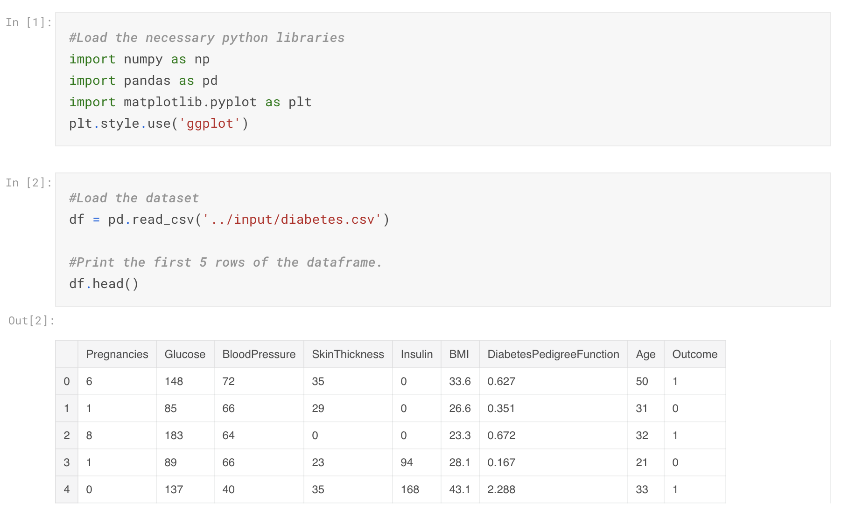
Python Implementation – kNN classiffier
kNN Classifier implementation – Load the data

Slide 5
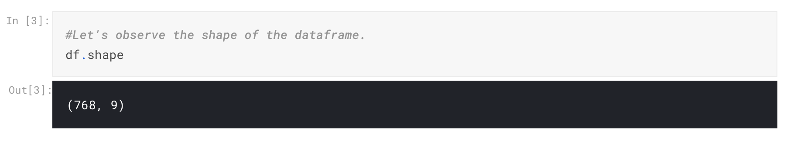
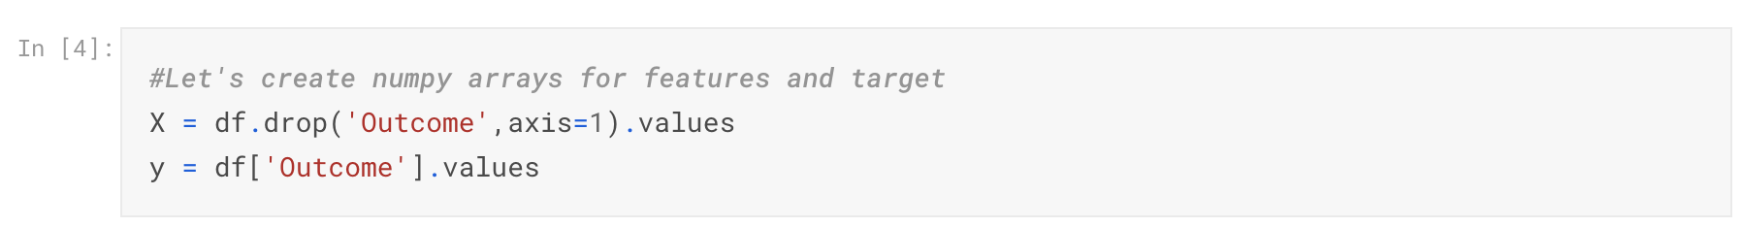
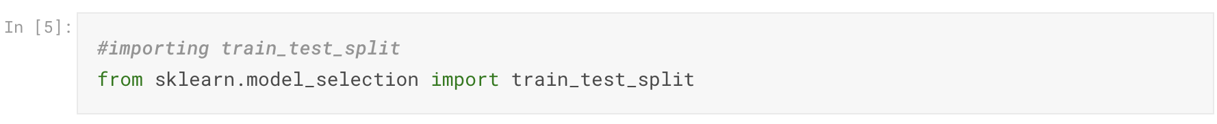
Python Implementation – kNN classiffier
kNN Classifier implementation – Split the dataset

Slide 6
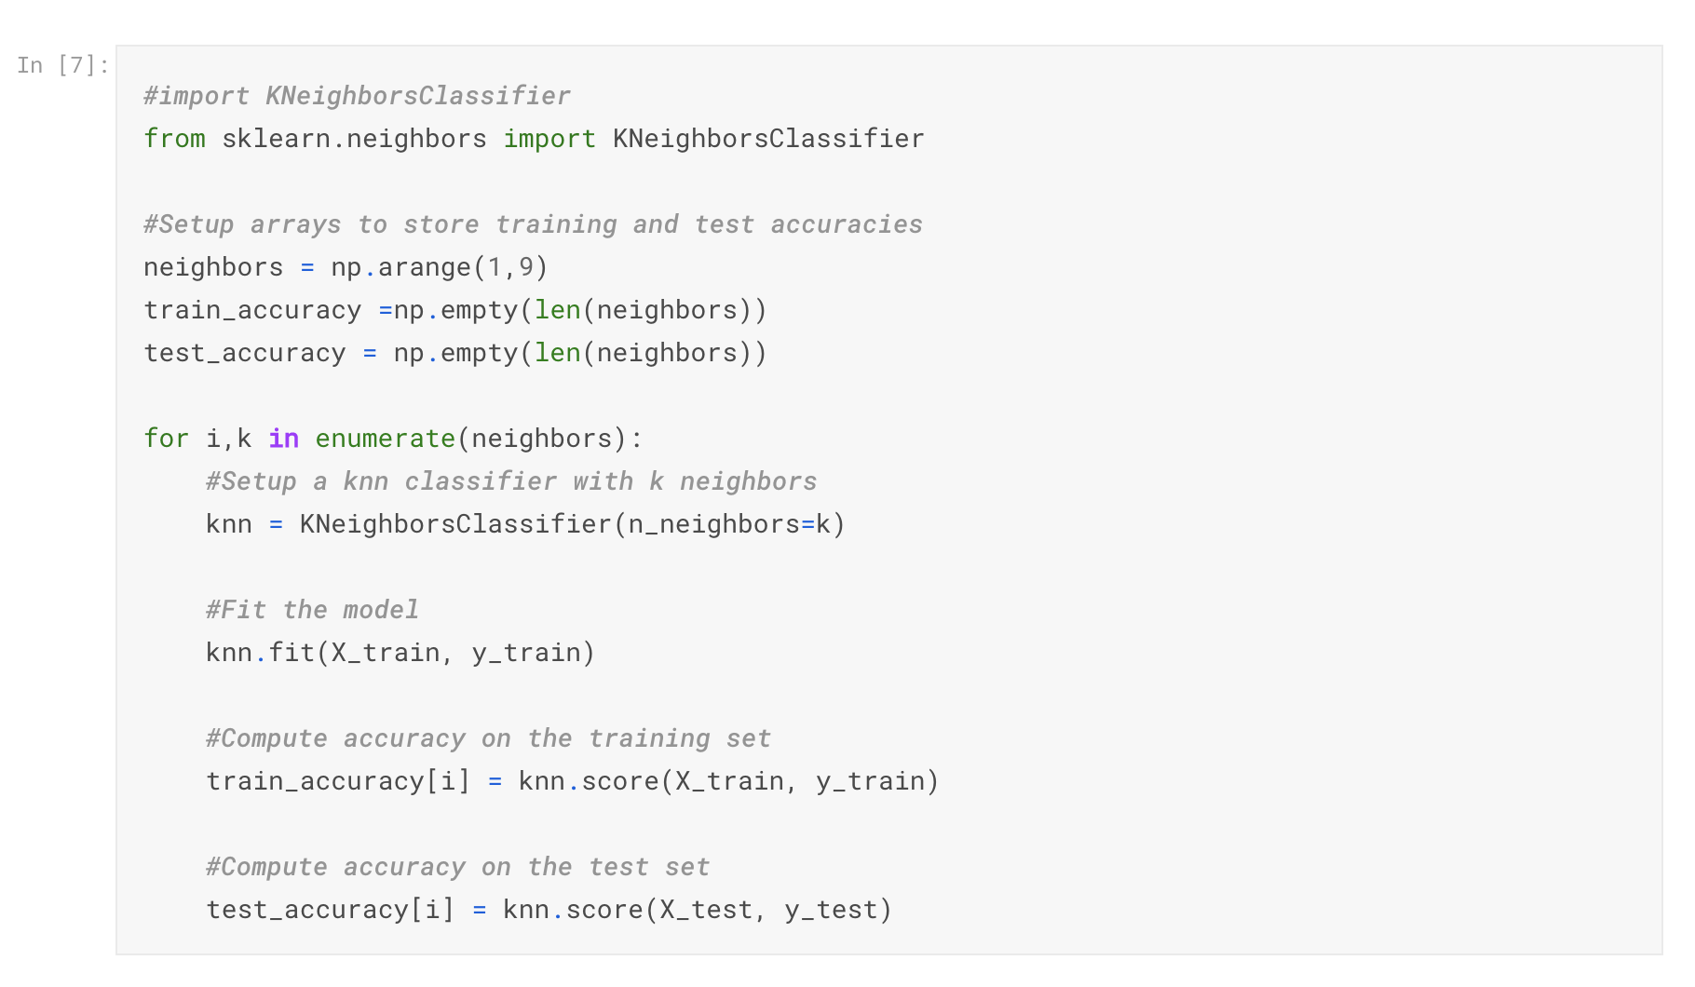
Python Implementation – kNN classiffier
kNN Classifier implementation – Build/Train model for broad range of k

Slide 7
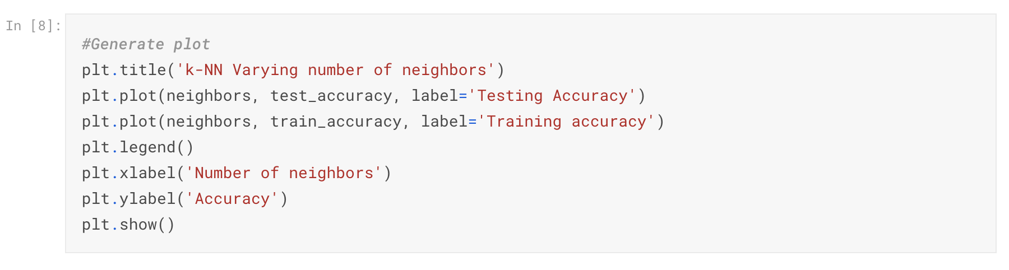
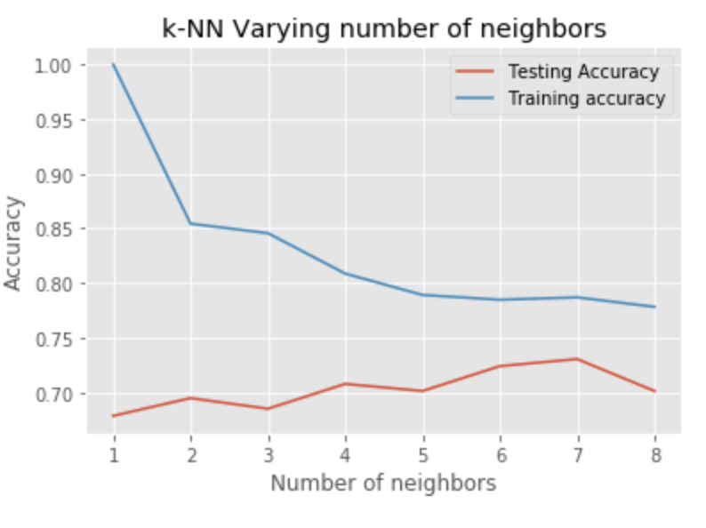
Python Implementation – kNN classiffier
kNN Classifier implementation – Plot the accuracy

Slide 8
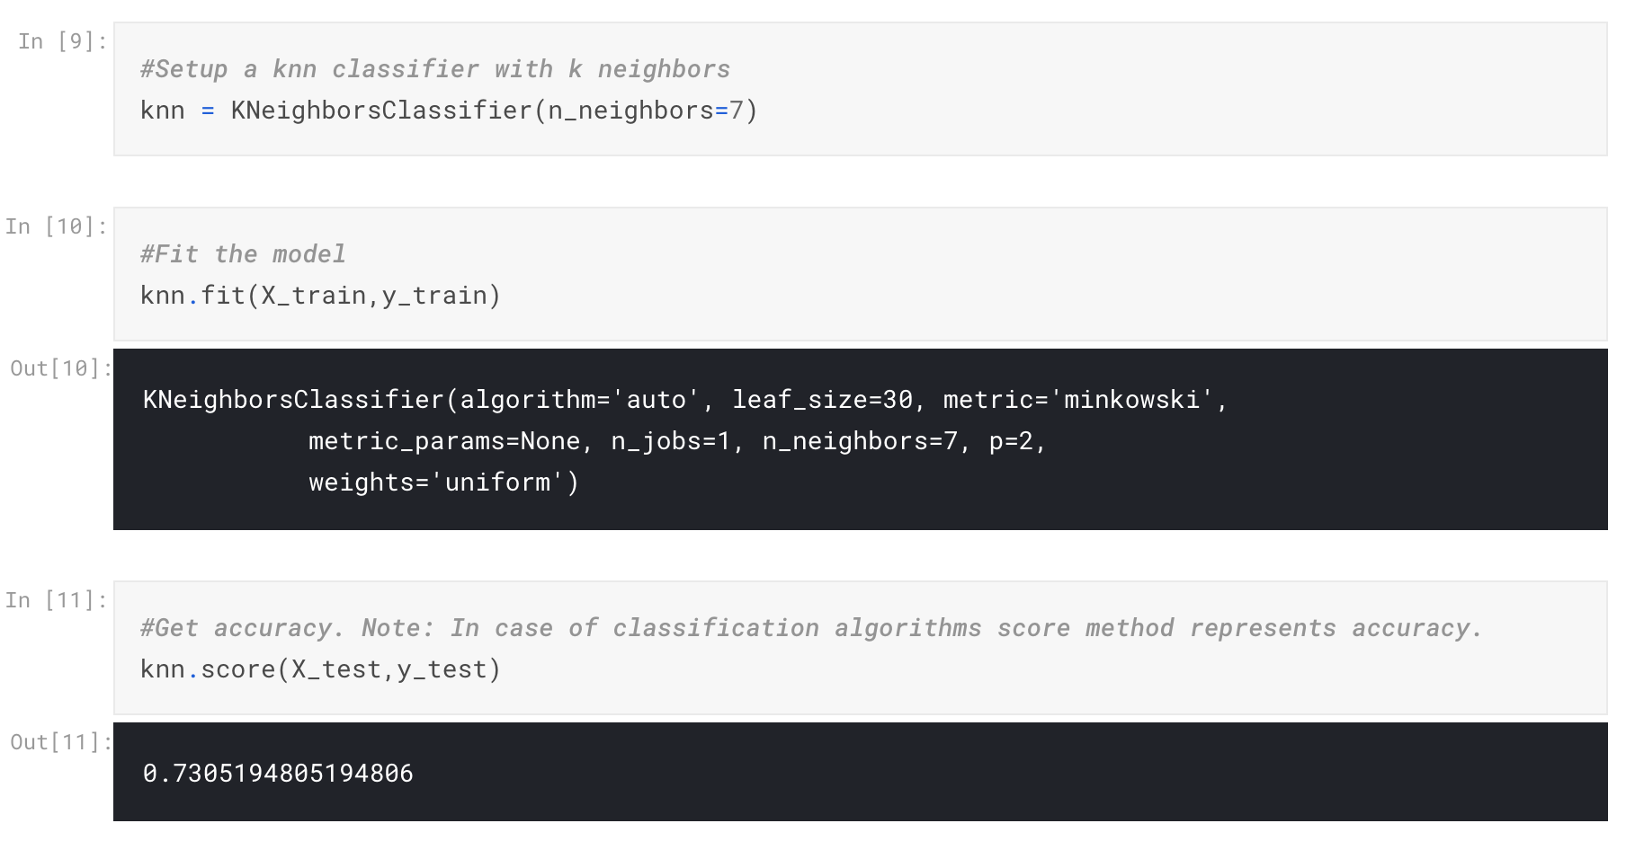
Python Implementation – kNN classiffier
kNN Classifier implementation – Fit the model for observed K

Slide 9
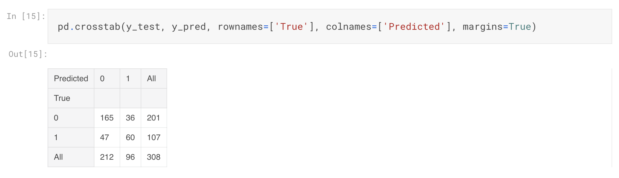
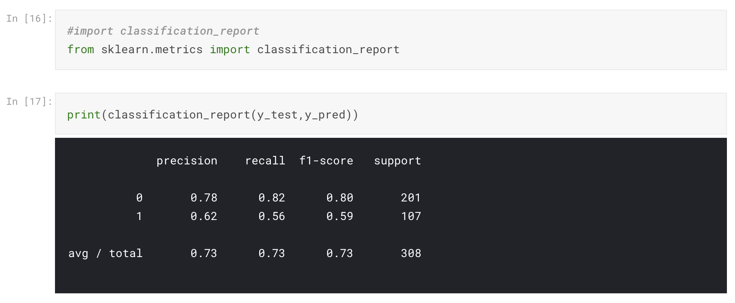
Python Implementation – kNN classiffier
kNN Classifier implementation – Measure the performance of classifier

Slide 10
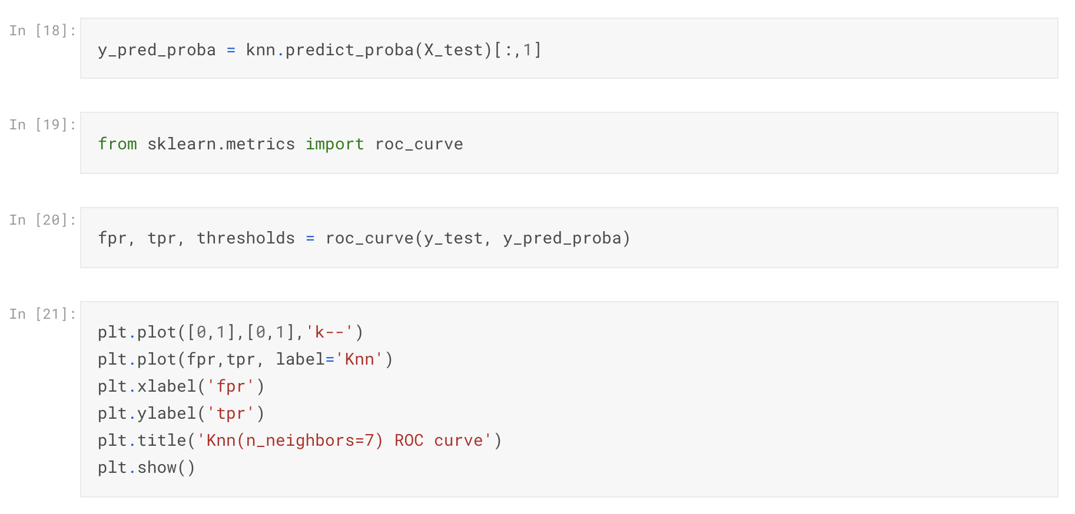
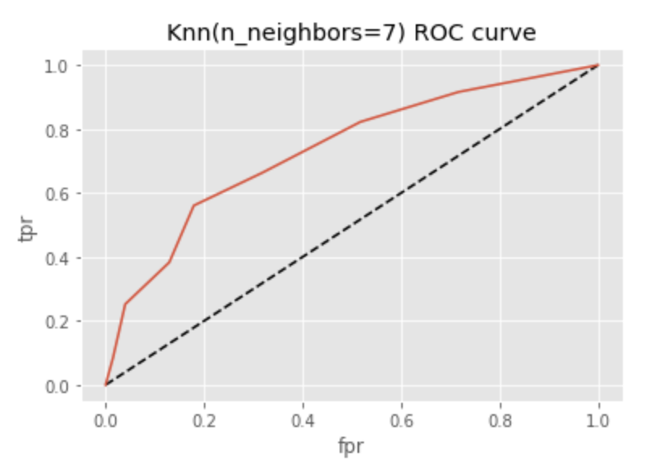
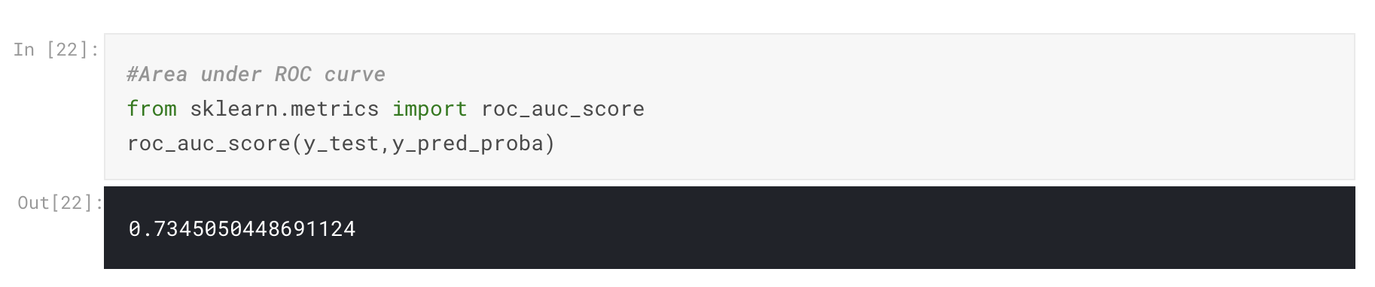
Python Implementation – kNN classiffier
kNN Classifier implementation – Plot ROC Curve

Slide 11
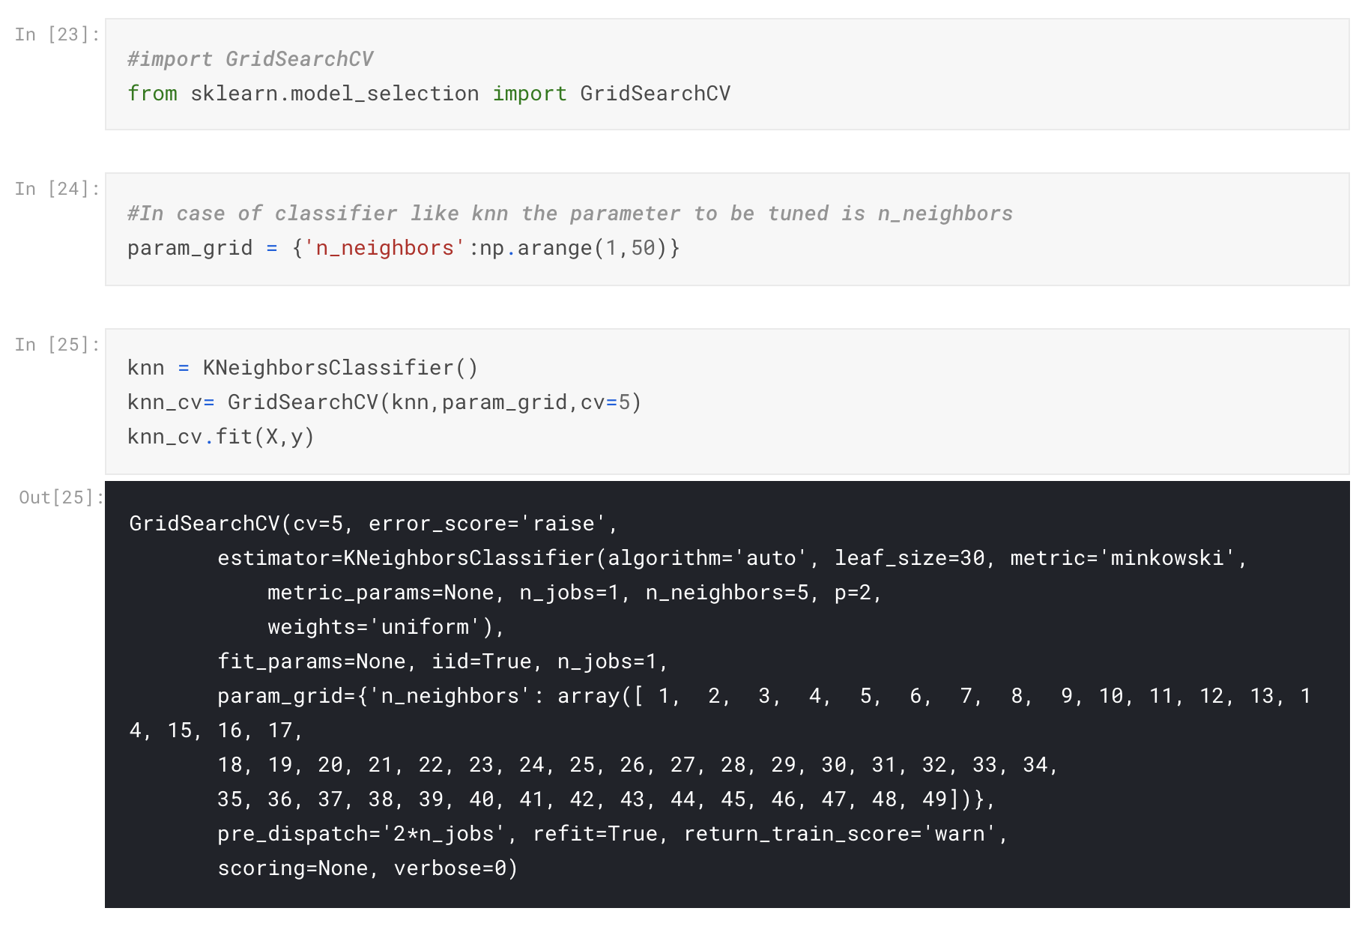
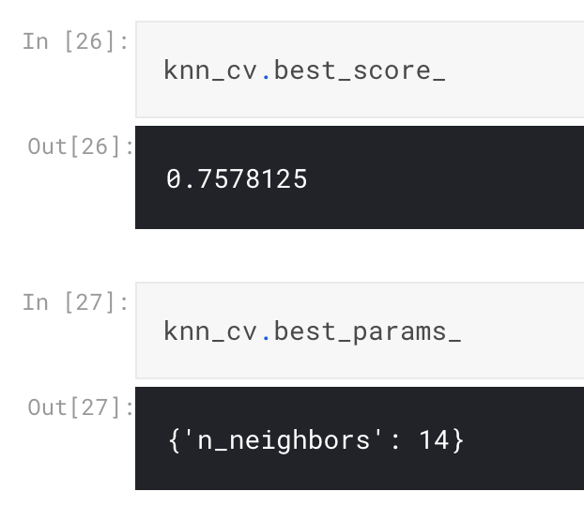
Python Implementation – kNN classiffier
kNN Classifier implementation – Hyperparameter Tuning & Cross Validation

Slide 12
Thank You!
In our next session:
Naïve Bayes Classifier

